Slide 1

UNIT 4: PUZZLES AND GAMES

Slide 2
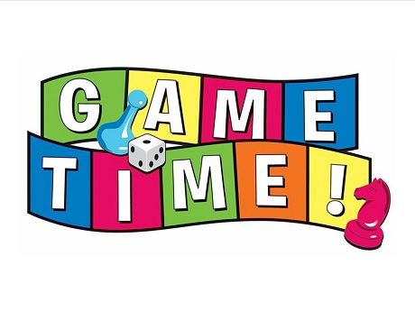

Slide 3

Which subject is it?
It is literature.

Slide 4
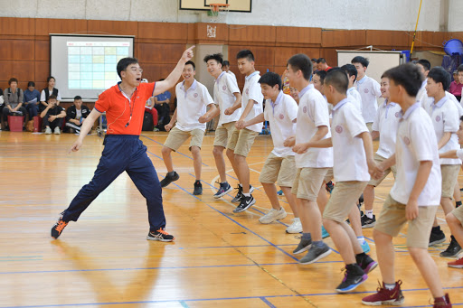
Which subject is it?
It is P.E/ Physical education.

Slide 5
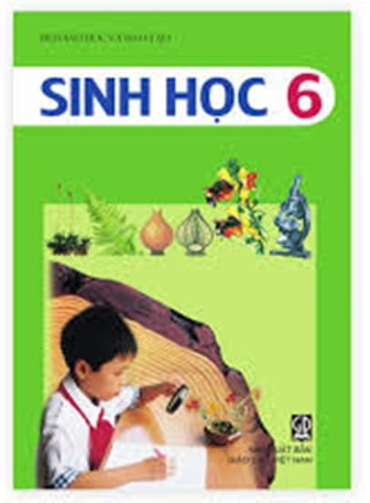
Which subject is it?
It is Biology.

Slide 6

Which subject is it?
It is Physics.

Slide 7

Which subject is it?
It is Geography.

Slide 8
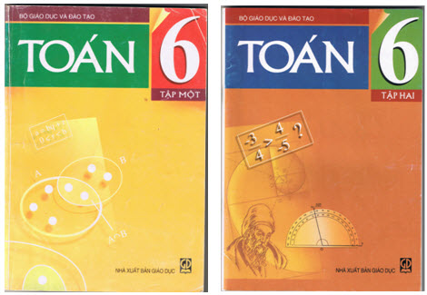
Which subject is it?
It is Maths.

Slide 9

Which subject are they learning?
They are learning Music.

Slide 10
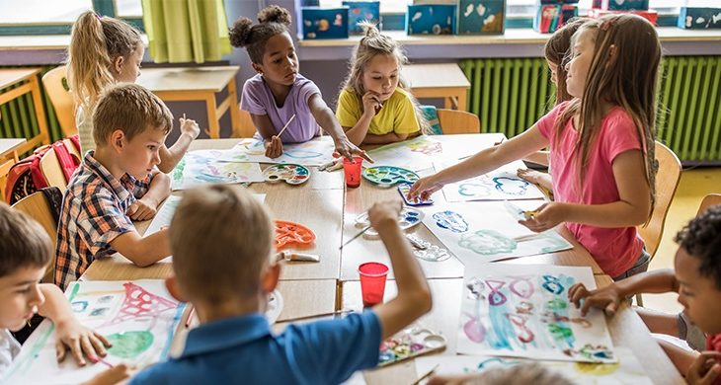
Which subject are they learning?
They are learning Art.

Slide 11
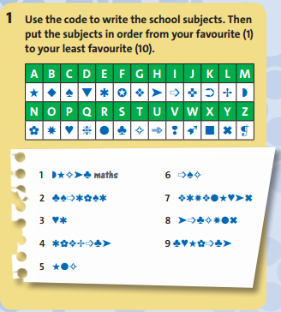
ICT
science
geography
PE
history
English
Spanish
art

Slide 12
Make a survey in groups:
Names | Your favorite subjects (the best -> the least)
Student 1 | ...
Student 2 | ...
Student 3 | ...
Student 4 | ...
-> Finally, our group likes ... best, and then ....
-> The least favorite subject of our group is ...

Slide 13
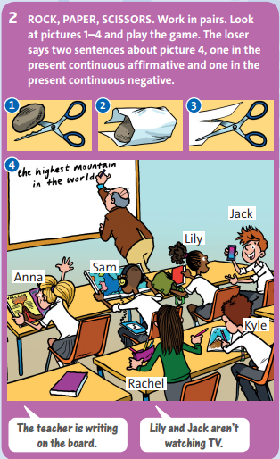

Slide 14
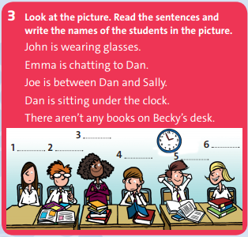
Becky
Sally
Emma
John
Joe
Dan

Slide 15
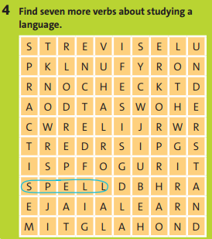

Slide 16

5/ MIME GAME:
Are you having lunch?
GAME RULES:
Work in groups of three.
Write five activities on pieces of paper.
Use the present continuous, for example, I’m having lunch.
One student takes a pieces of paper and mimes the sentence.
The first student to guess the correct sentence mimes the next sentence.
Are you having dinner?
No, I’m not.
Yes, I am.

Slide 17

* Homework: - Review the grammar structures and new words of unit 4. - Complete unit 4 tests, End-of-term 1 test, Teacher’s Resource Disk.

